Slide 1

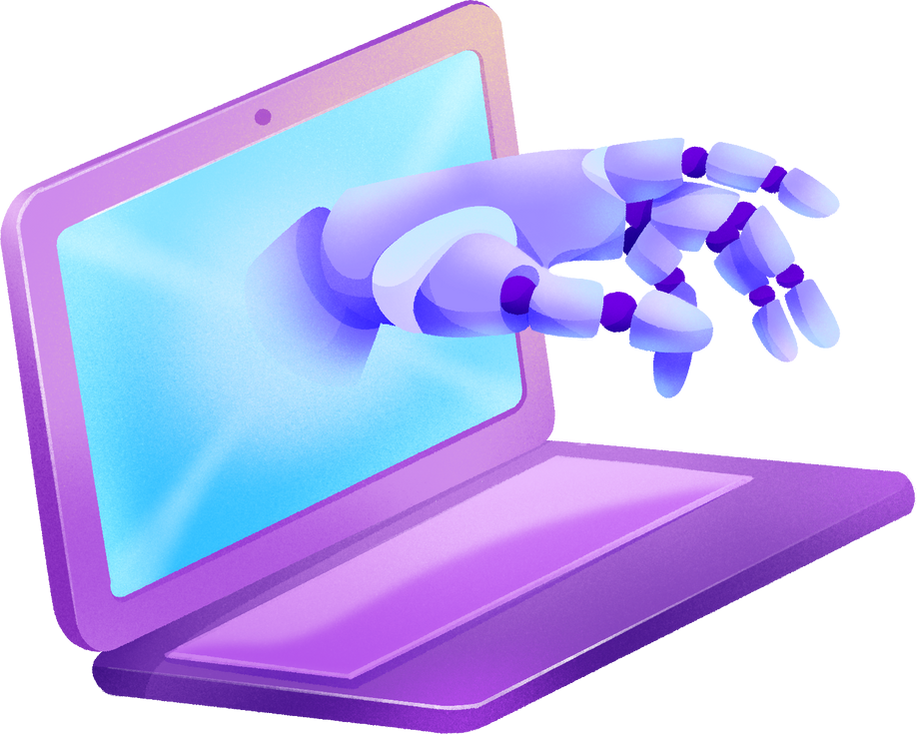
HOW DOES THE WEB WORK?
The web operates on a client-server model, where clients (browsers) request information from servers. This communication follows protocols like HTTP or HTTPS. The Domain Name System (DNS) translates human-readable domain names into IP addresses. Browsers render web pages by interpreting HTML, CSS, and JavaScript files received from servers.

Slide 2




WHAT DO YOU NEED
to be a web developer?
Programming Languages :
HTML, CSS, JavaScript
Basic Understanding of Databases :
MySQL, MongoDB
Responsive Design :
Ensure websites work on different devices

Slide 3








WHY LEARN WEB DEVELOPMENT?
HIGH DEMAND
Web developers are in high demand, offering numerous job opportunities
CONTINUOUS LEARNING
The field is dynamic, requiring continuous learning and adaptation to new technologies
POTENTIAL FOR ENTREPRENEURSHIP
Web development skills empower you to create and launch your projects and businesses

